Slide 1
Investing in Climate Action, investing in LIFE Detailed information on the 2014 call for proposals for action grants– guidance to applicants
12/06/2014 Greek workshop

Slide 2
Agenda
Guidance to applicants
Is LIFE for me?
Success rates
Timetable
Components of the 2014 LIFE call
Guidance and support
Application forms
LIFE CLIMA and IP award criteria
Key steps in preparing an application
What is eligible for co-funding
E-proposal tool
Key messages
Frequently asked questions – general guidance to applicants
Opportunity for Q&A

Slide 3
Is LIFE for me?
Be SURE that LIFE is the appropriate funding programme for your Environment and Climate Action project (NOT a structural fund, NOT an operational business financing tool, NOT a research tool)
READ the application guidelines
Be AWARE of all the exceptions that may apply to you
Ensure financial coherence; Watch COST EFFECTIVENESS
FOCUS - Do NOT include Actions not related to the objective of your proposal
CHECK whether your project fully fits with a priority project topic, or you will receive fewer points
The SELECTION procedure of LIFE is a very tough, through and detailed one.

Slide 4
Is LIFE for me? What awaits the beneficiaries I
Project management: minimum 1 full-time equivalent
Associated beneficiaries/Co-financers: As many as necessary to make it a success and as s/he can handle
Reporting: In English (annexes in language of the application (relevant translation costs incurred after project start are eligible) Every 18 months technical and financial progress reports, 1 progress report with 2nd pre-financing payment request (after consumption 1st pre-financing), 1 final report with payment request.

Slide 5
Is LIFE for me? What awaits the beneficiaries II
Monitoring obligations
Monitoring of Project Outcomes: Follow-up on the targeted environmental/climate outcomes related to at least one of the relevant outcome indicators and to the replicability/transferability of the related actions (MAWP)
Monitoring of Project Progress: Ensure timeliness and full compliance of the project with the proposal

Slide 6
Is LIFE for me? What awaits the beneficiaries III
Support: An external Monitoring Team (MoT) for technical and financial FAQ related to reporting and project management; EASME/Commission for IPs under the sub-programme for environment for bigger issues (modification requests, payments), but always through MoT
Visits: MoT: likely to involve a visit after project start, then approximately once a year; EASME/Commission are likely to visit during the lifetime of the project.
Knowledge Sharing, Publicity, and Recognition

Slide 7
Submission trend 2007-2012

Slide 8
Success rate consolidated

Slide 9
Timetable for 2014

Slide 10
Components of the 2014 LIFE call
Action grant projects:
LIFE Environment and Resource Efficiency (ENV)
LIFE Nature and Biodiversity (NAT)
LIFE Environmental Governance and Information (GIE)
LIFE Climate Change Mitigation (CCM)
LIFE Climate Change Adaptation (CCA)
LIFE Climate Governance and Information (GIC)
Preparatory Projects
Integrated Projects (sub-programme for environment only)
Technical Assistance Projects (sub-programme for environment only)
Capacity Building Projects
(NPO Operating Grants = separate call)

Slide 11
Guidance and support
Information sources include:
LIFE Regulation
Multiannual Work Programme
LIFE Web page, DG Climate Action web page
Application Packages
National Contact Points - when preparing the proposal, the applicants may wish to consult the relevant LIFE National Contact Point; the complete list of the names and contact addresses of the national authorities for LIFE in the Member States can be found on the LIFE website at
http://ec.europa.eu/environment/life/contact/nationalcontact/index.htm

Slide 12
Application forms and process
The application form includes:
Guidelines for Applicants (and forms)
Evaluation Guidelines
Model Grant and Common Provisions
Comparative Document (is LIFE the right instrument? Which strand?):
Vs. Horizon 2020 vs. structural funds
NAT (vs. BIO) vs. ENV vs. CCA vs. CCM // GIE vs. GIC?

Slide 13
Application forms and process – Environment or climate sub-programme
Environment
Projects falling under one of the project topics
Climate mitigation or adaptation is a by-product but not the central objective
Clear link to the specific objectives for the three environmental priority areas
Climate
Climate mitigation or adaptation is the main goal
Clear link to the specific objectives for the three climate action priority areas

Slide 14
Application forms and process – H2020 or LIFE climate sub-programme
H2020
LIFE CCM and CCA can support demonstration and pilot projects but also best practice projects
For Governance and Information priority areas under the CC sub-programme it is posible to support information, awareness and dissemination projects
Research activities must be strictly limited
LIFE Climate
Research and innovation actions where a strong element of research must be part of the project
Innovative actions which are more focused on pilot projects, prototypes, demonstration and market replication
SME instrument – three phase: feasibility/viability study; demonstration on a pilot level; commercialisation

Slide 15
Climate Action award criteria (2014-2017)
Overall pass score: 55 of 100 possible points

Slide 16
Integrated Project award criteria (2014-2017)
Overall pass score: 55 of 100 possible points

Slide 17
Key steps in preparing an application I
When preparing your proposal, the following main types of eligible actions must be clearly distinguished:
Preparatory actions (A Actions),
Land purchase/lease of land and/or compensation payment for land use rights (B Actions),
Concrete implementation actions (C Actions),
Monitoring of the impact of the project actions (D Actions),
Communication and dissemination actions (E Actions),
Project management and monitoring of project progress (F Actions).
To be taken eligible for funding, all actions must meet each of the following conditions:
the need of the action has to be well justified in view of the objectives of the project;
the long-term sustainability of the investments must be guaranteed.
See application guidelines for more detail on these actions

Slide 18
Key steps in preparing an application II
READ the application guidelines
Be SURE that LIFE is the appropriate funding programme for your Environment and Climate Action project (NOT a structural fund, NOT an operational business financing tool, NOT a research tool)
Be AWARE of all the exceptions that may apply to you
Ensure financial coherence; Watch COST EFFECTIVENESS
FOCUS - Do NOT include Actions not related to the objective of your proposal
CHECK whether your project fully fits with a priority project topic, or you will receive fewer points
The SELECTION procedure of LIFE is a very tough, thorough and detailed one.

Slide 19
Key steps in preparing an application III
Common reasons for failure:
No clear EU relevant environmental or climate action focus
Not convincingly demonstrative, pilot or best practice
Key points to remember: LIFE does not finance:
Compensatory action under Art. 6 of the Habitats directive
Actions that should be (or are) financed under Structural Funds or CAP
Research projects
Be clear and precise – applications are evaluated on what is submitted (not on the potential of the idea)
Read documents
Read about and talk to ongoing projects
Start preparing early and make use of all available resources
http://ec.europa.eu/environment/life/index.htm

Slide 20
Key steps in preparing an application III
Common reasons for failure:
No clear EU relevant environmental or climate action focus
Not convincingly demonstrative or pilot
Key points to remember: Life does not finance:
Compensatory action under Art. 6 of the Habitats directive
Actions that should be (or are) financed under Structural Funds or CAP
Research projects
Be clear and precise – applications are evaluated on what is submitted (not on the potential of the idea)
Read documents
Read about and talk to ongoing projects
Start preparing early and make use of all available resources
http://ec.europa.eu/environment/life/index.htm

Slide 21
What is eligible for co-funding
In general: All cost directly related to the project objectives
Personnel costs (if public authority: 102% rule)
External assistance (limited to 35% of the budget)
Equipment (special rules on depreciation)
Overheads (limited to 7%)
Consumables/Other costs
Land purchase (only for nature or climate change objectives, and with dedication to nature purposes)

Slide 22
E-proposal tool
Full online process
Preparation / Submission
Communication
Revision
Amendment
Structured data
Can allow third parties to see applications in development
https://webgate.ec.europa.eu/eproposalWeb/
The application tool contains all administrative (A), technical (B and C) and financial (F) forms required, and functionalities to attach relevant documents (maps, photos, diagrams, graphs, mandatory administrative and financial annexes). Guidelines to applicants will provide complete details regarding the use of the eProposal tool and the application forms. .

Slide 23
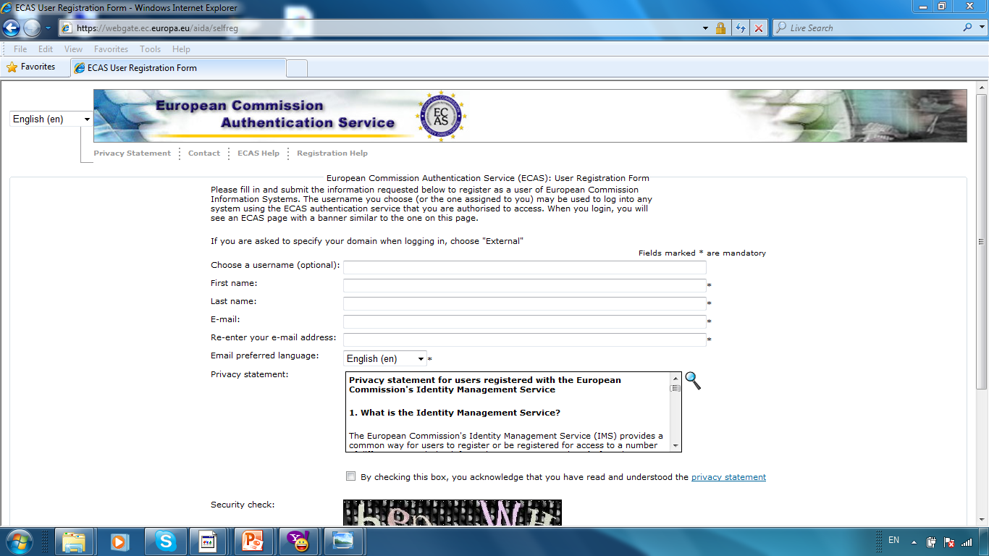
E-proposal tool

Slide 24
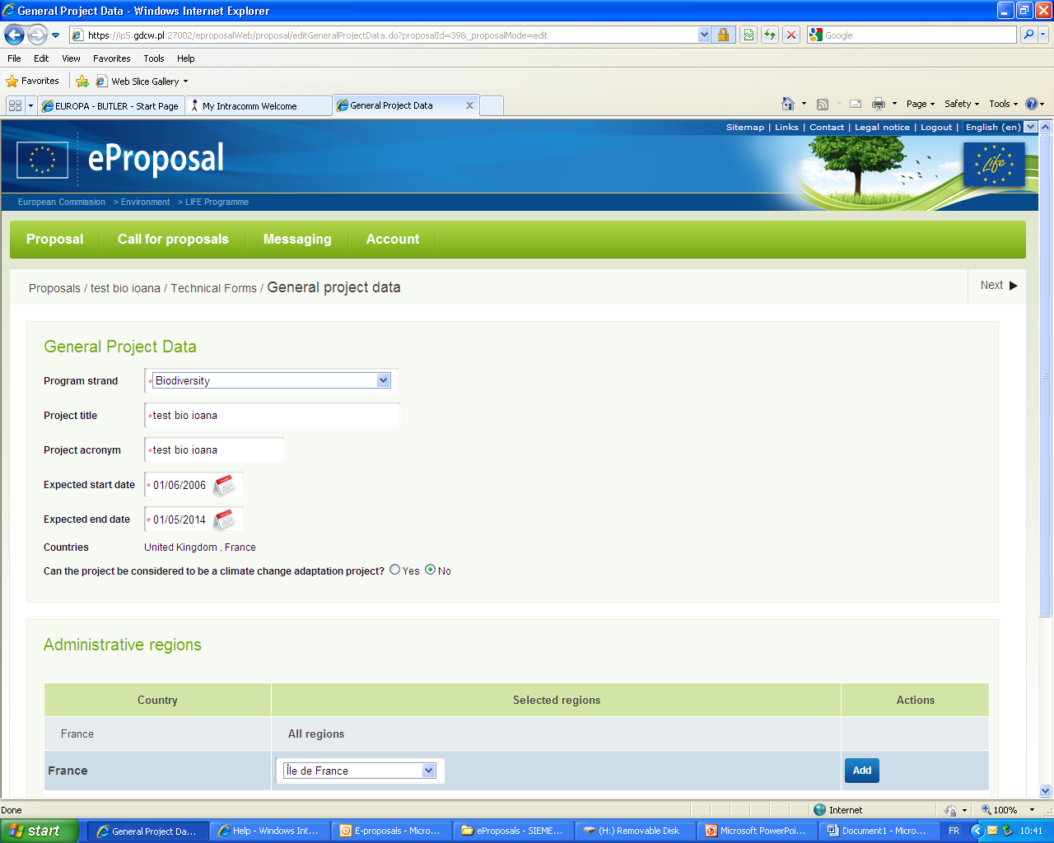
E-proposal tool

Slide 25
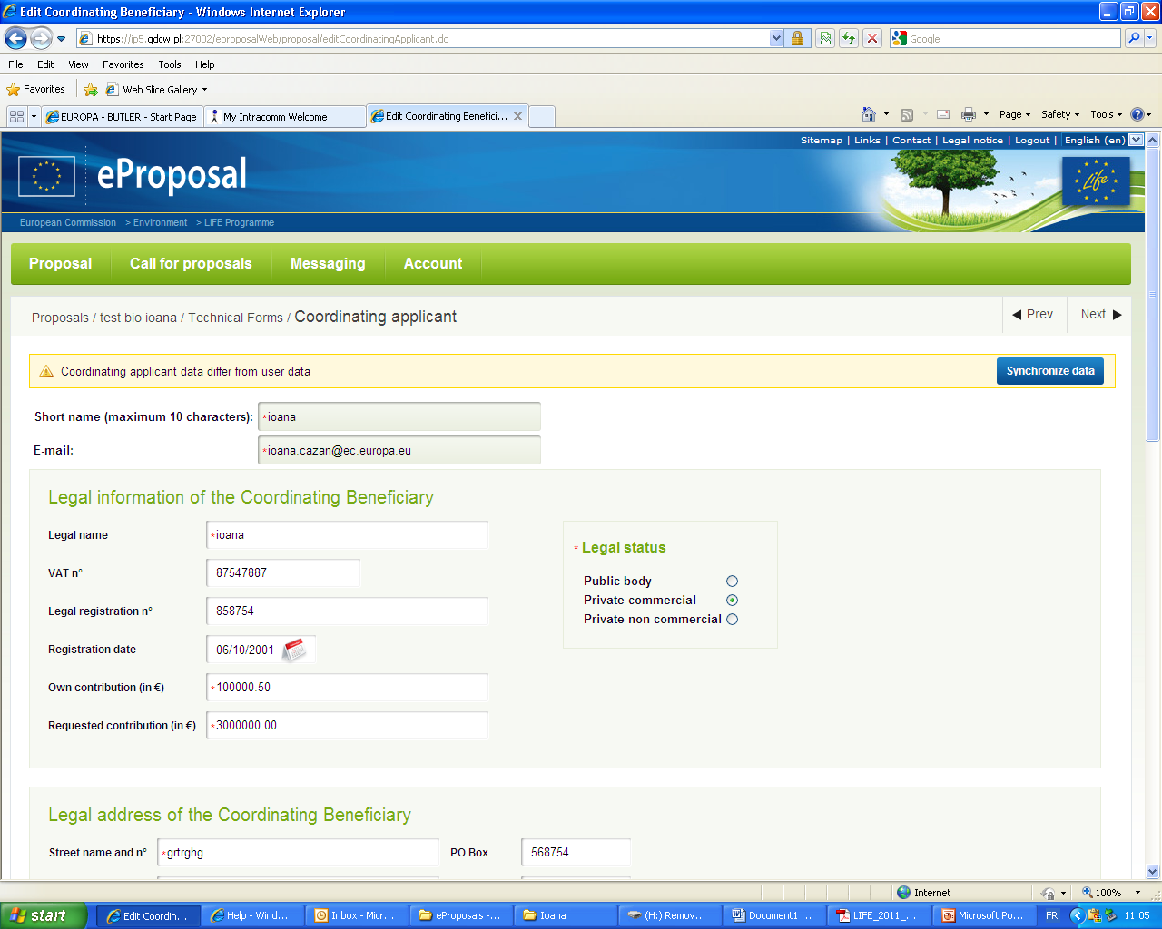
E-proposal tool

Slide 26
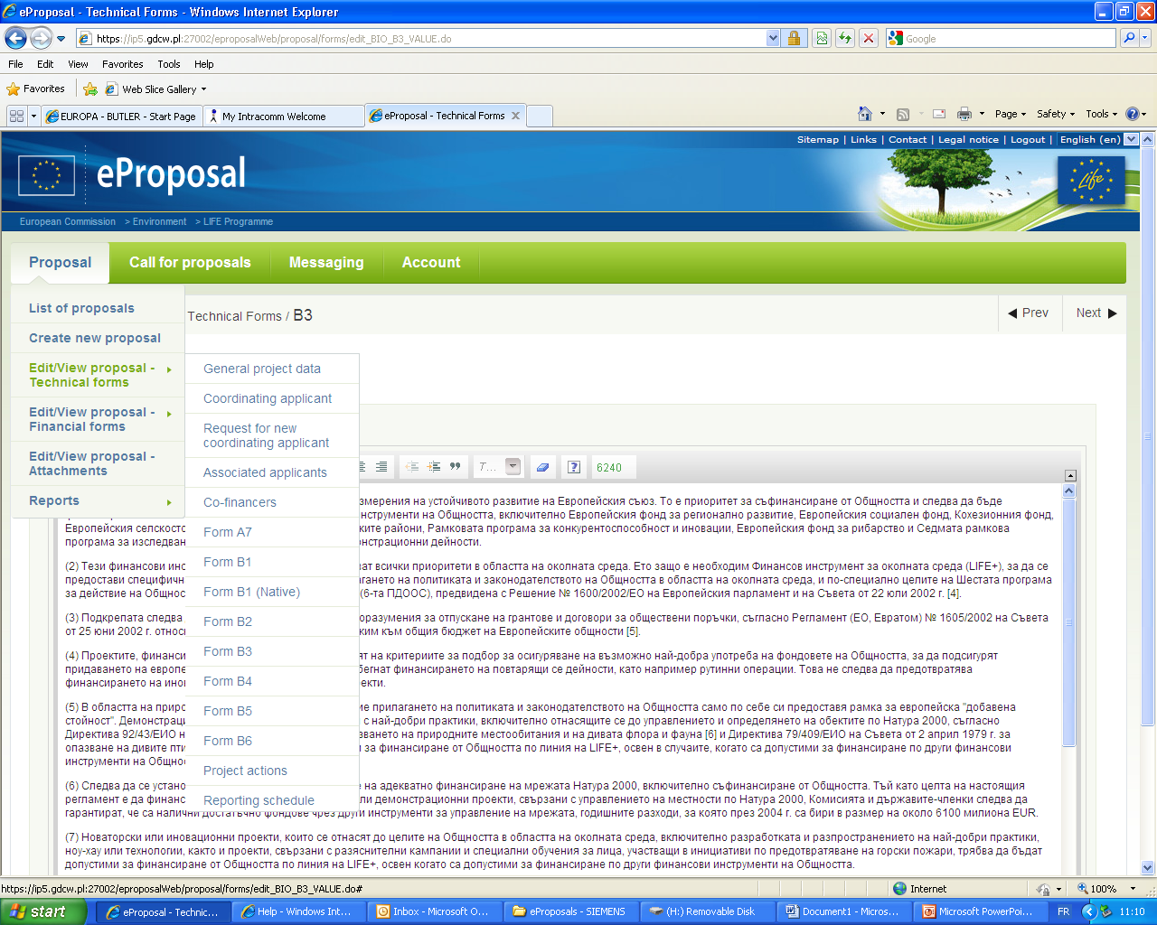
E-proposal tool

Slide 27
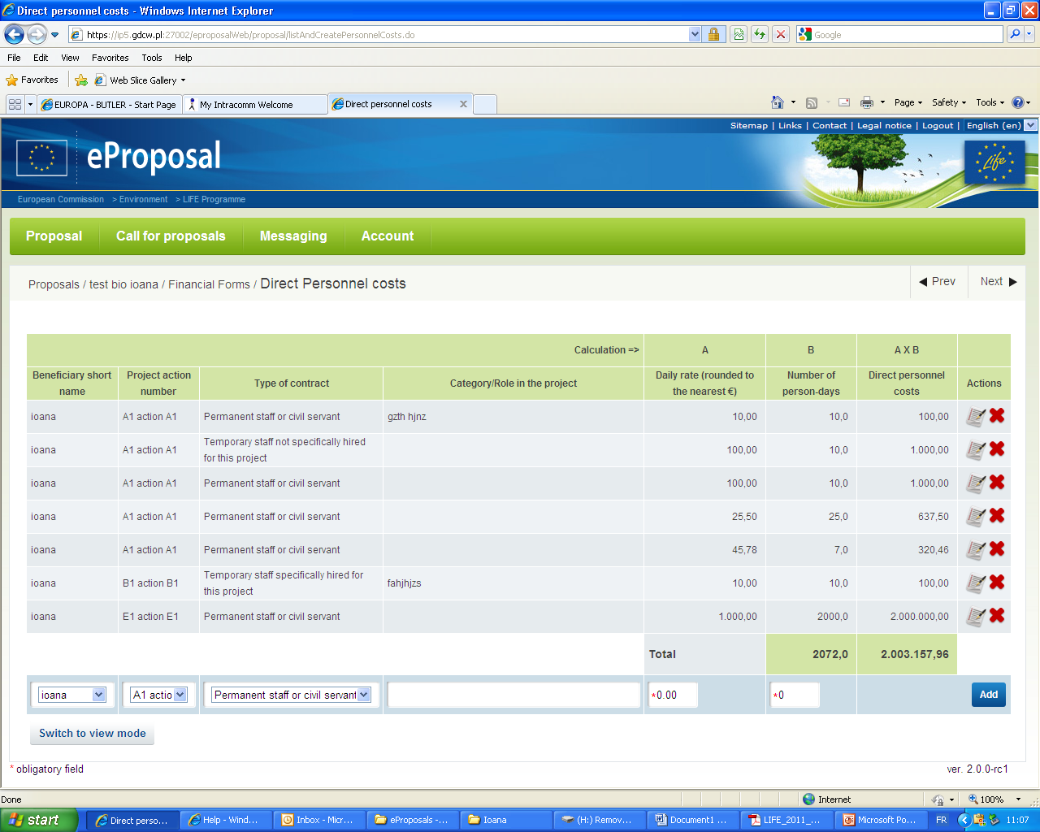
E-proposal tool

Slide 28
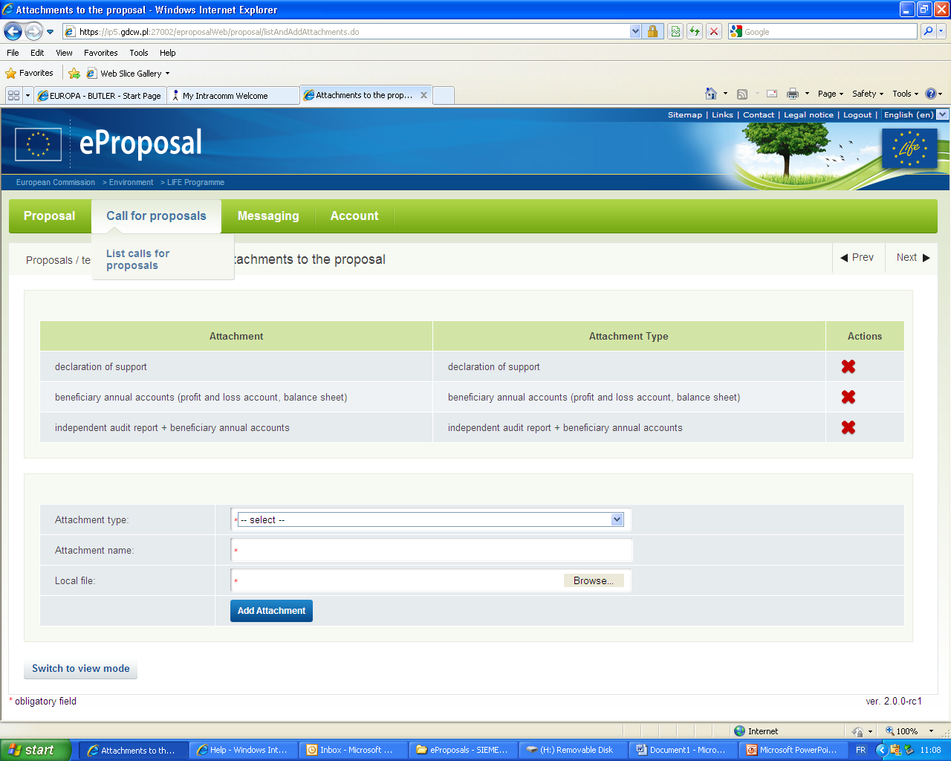
E-proposal tool

Slide 29
Key messages
There is significant competition for LIFE funds
You can't get a grant if you don't submit an application – on time...
It takes time and money to prepare an application
Proposals that fail are poorly prepared.

Slide 30
Frequently Asked Questions: General Guidance to Applicants
In which language may the proposal be submitted?
The Contracting Authority recommends that applicants fill in the technical part in English, although proposals may be submitted in any of the official EU languages, except Irish/Maltese. The grant agreement, project management, formal reporting and all communication with the Contracting Authority have to be in English.
The title of the proposal and form B1 ("Summary description of the project") must always be submitted in English. Form B1 may also be submitted in the language of the proposal.
Who may submit a proposal?
A proposal may be submitted by any legal person registered in the European Union.
Applicants may fall into three types of beneficiaries: (1) public bodies (public authorities), (2) private commercial organisations and (3) private non-commercial organisations (including NGOs).
Who may participate in a project?
Once a proposal has been accepted for co-funding, the applicant will become the coordinating beneficiary who is legally and financially responsible for the implementation of the project.
An associated beneficiary may be legally registered outside the European Union, provided that the coordinating beneficiary is based in the EU. Any activities to be carried out outside the EU must be necessary to achieve EU climate objectives and to ensure the effectiveness of interventions carried out in the Member State territories to which the Treaties apply. There is no obligation to involve associated beneficiaries in a LIFE proposal.
A project co-financer only contributes to the project with financial resources, has no technical responsibilities, and cannot benefit from the EU financial contribution.

Slide 31
Frequently Asked Questions: General Guidance to Applicants
What is the optimal budget for a LIFE project?
There is no fixed minimum size for project budgets. While large ambitious projects (i.e. over EUR 5 million total costs) have been financed several times in the past, very small projects (i.e. below EUR 500,000 total costs) have seldom succeeded due to the limited output and consequently the low added value.
What is the maximum rate of EU co-financing under LIFE?
For the duration of the first LIFE multiannual work programme for 2014-2017, the maximum EU co-financing rate for LIFE action grant projects is 60% of the total eligible project costs.
How much should project beneficiaries contribute to the project budget?
The coordinating beneficiary and any associated beneficiaries are expected to provide a reasonable financial contribution to the project budget.
What is the optimal starting date and duration for a project?
The earliest possible starting date for these projects is 16 July 2015. Any costs incurred before the project's starting date will not be considered eligible and cannot be included in the project budget.
the project duration must correspond to what is necessary to complete all of the project's actions and to reach all its objectives. Most projects last for 2–5 years.
Outsourcing of project activities
The beneficiaries should have the technical and financial capacity and competency to carry out the proposed project activities. It is therefore expected that the share of the project budget allocated to external assistance should remain below 35%.

Slide 32
Frequently Asked Questions: General Guidance to Applicants
How long should a LIFE proposal be?
A proposal should be as concise and clear as possible. Applicants should avoid voluminous proposals and should not provide excessively detailed descriptions. Clear and detailed descriptions should, however, be provided for all project actions.
Long term sustainability of the project and its actions
It is obligatory that throughout the duration of the project, the beneficiaries consider how these investments will be secured, maintained, developed and made use of or replicated after the end of the project. This should be built into the proposal.
Replication and dissemination
LIFE projects are expected to be widely replicated and results disseminated in order to ensure a strong European added value beyond the investment into the LIFE project itself.
Research activities
Whereas EU funding for research activities is provided under Horizon 2020 – the Framework Programme for Research and Innovation (2014–2020), limited research aimed to improve and enhance the knowledge data underpinning the project may be carried out within a LIFE project.
Complementarity with other EU funding programmes
According to Article 8 of the LIFE Regulation, activities supported from the LIFE Programme must ensure consistency and synergies, and avoid overlap with other funding programmes of the Union. It is essential that beneficiaries check whether the actions proposed under their project in practice could be, or are, funded through other EU funds.

Slide 33
Opportunity for Q&A

